Slide 1


RAG con Listas de SharePoint

Slide 2









Sponsors
Gold
Raffle
Collaborator
Notes:
Use this as the first slide in your slide deck

Slide 3
Ruben Toribio
AI Expert @ DNV
rtoribiog
Luis Mañez
Chief Architect @ ClearPeople
luismanez

Slide 4
01
RAG Pattern

Slide 5
Bringing Private Knowledge to LLMs
Fine tuning
Learn new skills
Retrieval
augmentation
Learn new facts

Slide 6
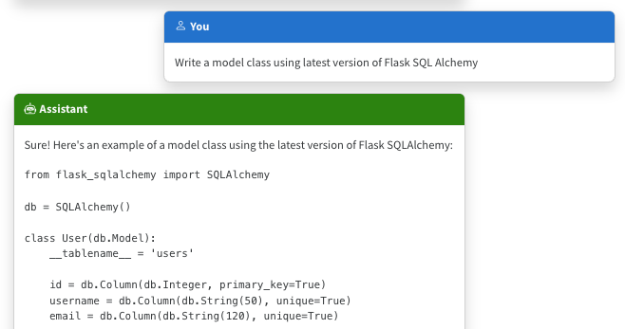
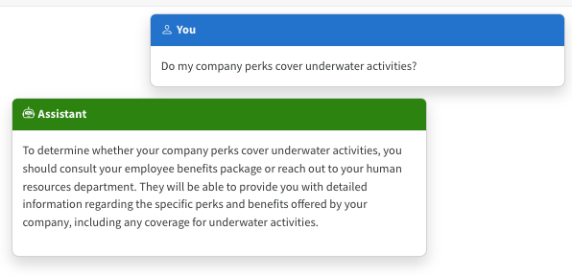
The Limitations of LLMS
Outdated public knowledge
No internal knowledge

Slide 7
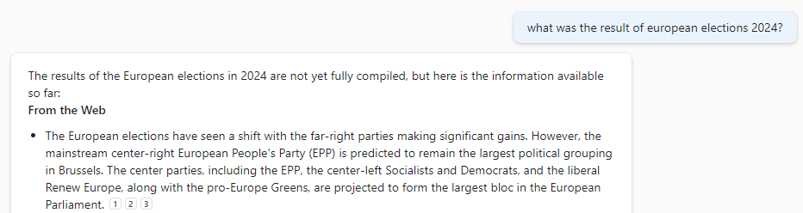
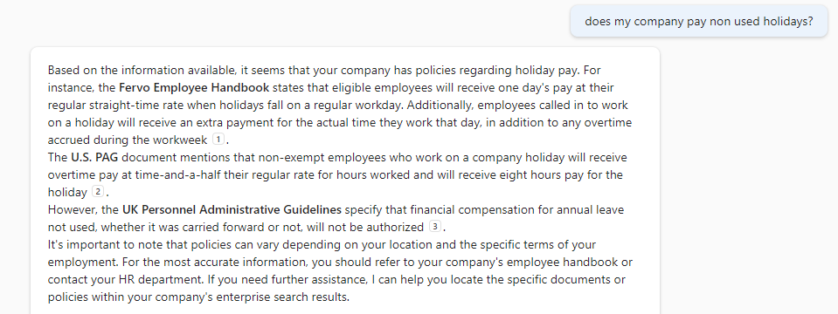
The benefit of RAG
Up-to-date public knowledge
Access to internal knowledge

Slide 8









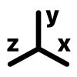













RAG Deep Dive
Documents Storage
Indexing
Text extraction
Chunking
Embeddings
Index
[-0.004828, -0.02983]
[-0.004828, -0.02983]
Chunk payload
await memory.ImportDocumentAsync("Data/expenses.xlsx");
[-0.004828, -0.02983]
Chunk Embeddings
[-0.004828, -0.02983]
Plain text
[-0.004828, -0.02983]
Metadata
………….
Retrieve
Generation
Context
[-0.004828, -0.02983]
payload + metadata 1
User query
[-0.004828, -0.02983]
[-0.004828, -0.02983]
payload + metadata 2
var answer = await memory.AskAsync(query);
[-0.004828, -0.02983]
payload + metadata 3
User query

Slide 9
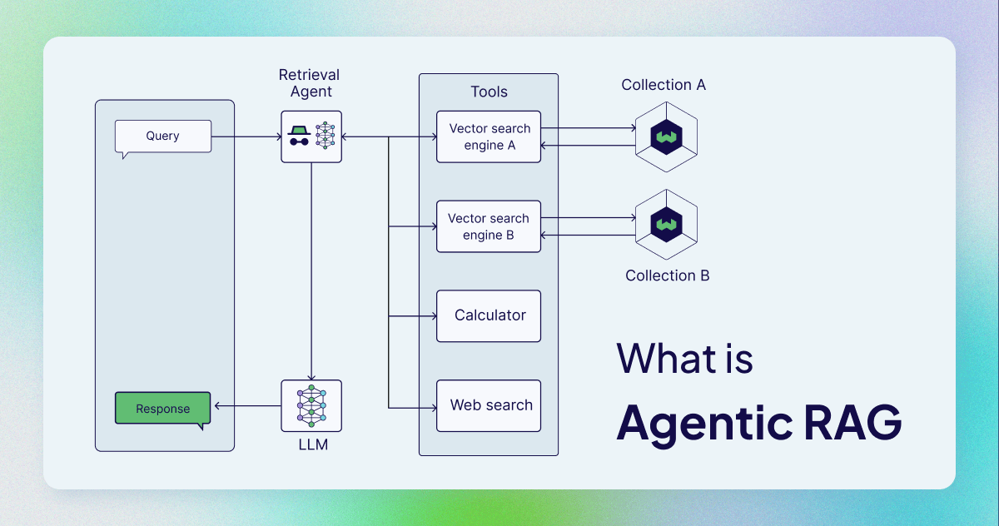
RAG Agent

Slide 10


Slide 11
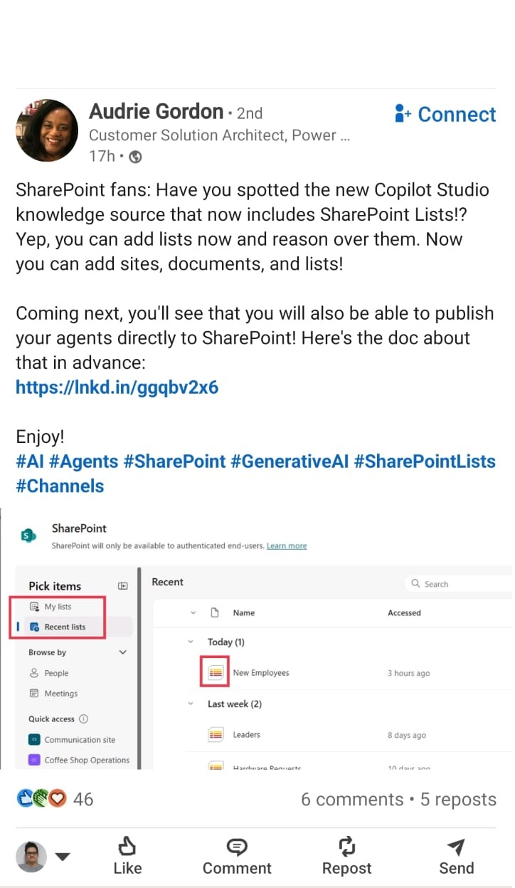
SharePoint Lists
Will be included in Copilot Studio

Slide 12


Slide 13
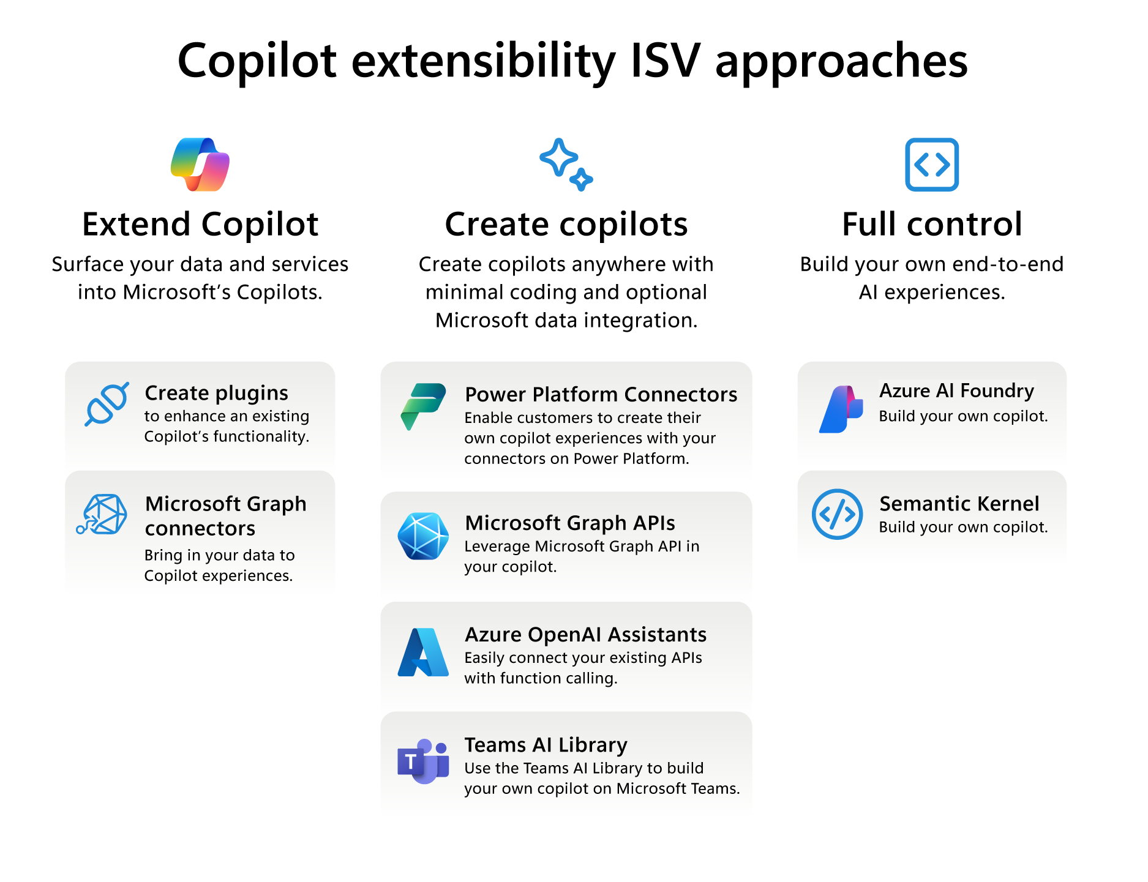
Extensibility in Copilot

Slide 14


Show me the code !!

Slide 15
Resources
https://github.com/luismanez/collabdays-madrid-2025

Slide 16
Thank you!
Questions?

